Slide 1
UNIT-IV

Slide 2
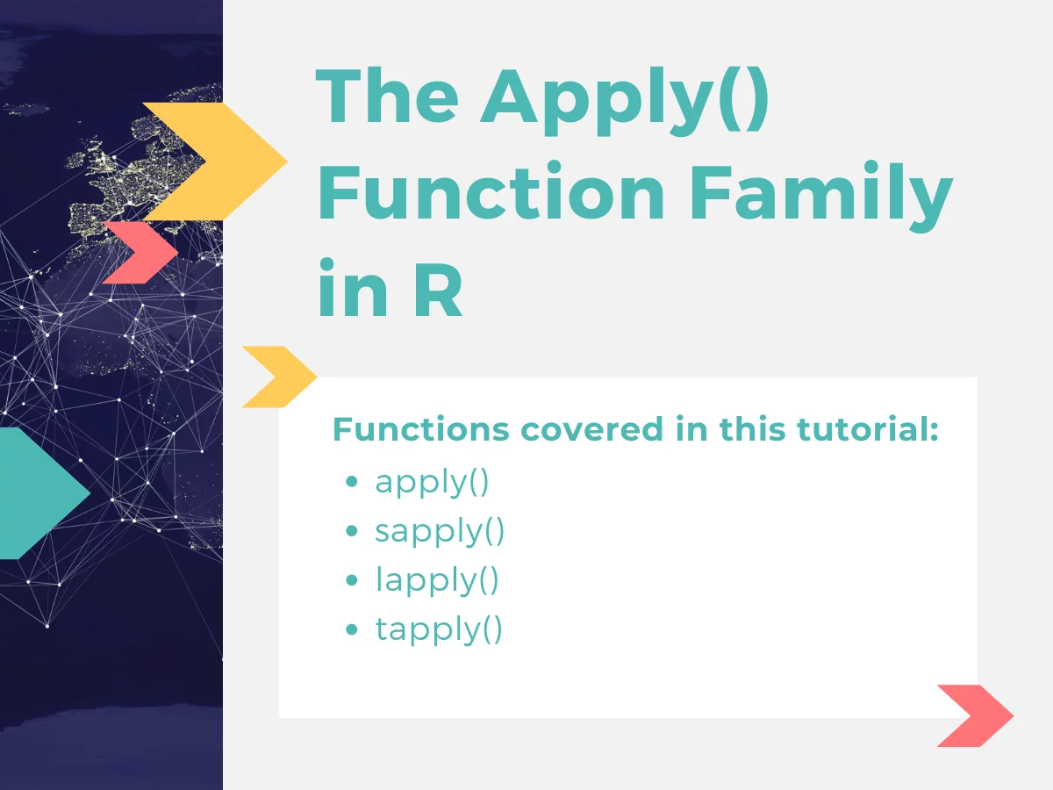

Slide 3
Apply():
Apply functions to manipulate slices of data from matrices, arrays, lists and data frames in a repetitive way.
An apply function is essentially a loop, but run faster than loops and often require less code.
The apply family of functions is a built-in family that appears with the built-in packages in R

Slide 4
Apply family in R:
Following is the list of functions that are a part of the apply family.
apply() : for matrices and data frames
lapply(): for lists…output as list
sapply(): for lists…output simplified
tapply(): for vectors
mapply()
vapply()
These functions are differentiated based on the data structure they are applicable on (vectors, data frames, matrices, etc.)

Slide 5
The apply function:
apply() takes Data frame or matrix as an input and gives output in vector, list or array.
The apply() function is most often used to apply a function to the rows or columns (margins) of matrices or data frames.
The syntax for apply() is
apply(x,MARGIN,FUN,…)
x is the matrix, dataframe or array
-MARGIN: take a value or range between 1 and 2 to define where to apply the function:
-MARGIN=1`: the manipulation is performed on rows
-MARGIN=2`: the manipulation is performed on columns
-MARGIN=c(1,2)` the manipulation is performed on rows and columns
-FUN: tells which function to apply.

Slide 6
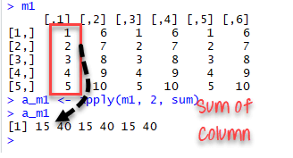
Apply():Example1
m1 <- matrix(1:10,nrow=5, ncol=6)
m1
a_m1 <- apply(m1, 2, sum)
a_m1

Slide 7
Apply():Example2
data <- matrix(1:9, nrow=3, ncol=3)
data
[,1] [,2] [,3]
[1,] 1 4 7
[2,] 2 5 8
[3,] 3 6 9
apply(data, 1, sum)
O/P: [1] 12 15 18

Slide 8
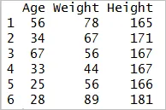
Apply():Example3
Create data frame:
Age<-c(56,34,67,33,25,28)
Weight<-c(78,67,56,44,56,89)
Height<-c(165, 171,167,167,166,181)
BMI_df<-data.frame(Age,Weight,Height)
BMI_df

Slide 9
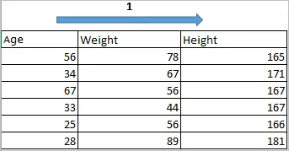
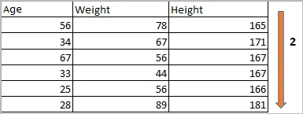
apply(BMI_df,2,sum)
apply(BMI_df,1,sum) O/p: [1] 299 272 290 244 247 298
apply(BMI_df,2,sum)
O/P: Age Weight Height
243 390 1017

Slide 10
lapply() function:
lapply is applied for operations on a list of objects and returns a list object of same length.
The lapply() function does the following simple series of operations:
it loops over a list, iterating over each element in that list
it applies a function to each element of the list (a function that you specify)
and returns a list (the l is for “list”).
Syntax:
lapply(x,FUN,…)
X : is the list
FUN: is the function to be applied
... : s for any other arguments to be passed to the function

Slide 11
lapply() :Example 1
data <- list(item1 = 1:5,
item2 = seq(4,36,8),
item4 = c(1,3,5,7,9))
Data
lapply(data, sum)
O/P
$item1 [1] 15
$item2 [1] 48
$item4 [1] 25

Slide 12
lapply() :Example 2
>Names<-c("Manish","Saurabh", "Rahul","Krishna","Venkat")
>Names_lower<-lapply(Names,tolower)
>Names_lower
>Names_upper<-lapply(Names,toupper)
>Names_upper

Slide 13
sapply() function:
The sapply() and lapply() work basically the same.
The only difference is that lapply() always returns a list, whereas sapply() tries to simplify the result into a vector or matrix.
If the return value is a list where every element is length 1, you get a vector.
If the return value is a list where every element is a vector of the same length (> 1), you get a matrix.
If the lengths vary, simplification is impossible and you get a list.

Slide 14
sapply() :Syntax
The syntax for sapply() is as follows:
sapply(x,FUN,…)
Parameter | Condition | Description
x | Required | A list
FUN | Required | The function to be applied
… | Optional | Any other arguments to be passed to the FUN function

Slide 15
sapply() :Example
Get the sum of each list item and simplify the result into a vector
data <- list(item1 = 1:5,
item2 = seq(4,36,8),
item4 = c(1,3,5,7,9))
data
$item1 [1] 1 2 3 4 5
$item2 [1] 4 12 20 28 36
$item4 [1] 1 3 5 7 9
sapply(data, sum)
item1 item2 item4
15 100 25

Slide 16
tapply() Function:
tapply() is used to apply a function over subsets of a vector. It is primarily used when we have the following circumstances:
A dataset that can be broken up into groups (via categorical variables - aka factors)
We desire to break the dataset up into groups
Within each group, we want to apply a function

Slide 17
tapply() :Syntax
Syntax
tapply(x,INDEX,FUN,…,simplify)
Parameter | Condition | Description
x | Required | A vector
INDEX | Required | A grouping factor or a list of factors
FUN | Required | The function to be applied
… | Optional | Any other arguments to be passed to the FUN function
simplify | Optional | Returns simplified result if set to TRUE. Default is TRUE. simplify, should we simplify the result?

Slide 18
tapply() :Example
head(mtcars)
tapply(mtcars$mpg, mtcars$cyl, mean)
data(iris)
summary(iris)
tapply(iris$Sepal.Length,iris$Species,median)

Slide 19
Difference between apply(), sapply() and `lapply()
Function | Arguments | Objective | Input | Output
apply | apply(x, MARGIN, FUN) | Apply a function to the rows or columns or both | Data frame or matrix | vector, list, array
lapply | lapply(X, FUN) | Apply a function to all the elements of the input | List, vector or data frame | list
sapply | sapply(X, FUN) | Apply a function to all the elements of the input | List, vector or data frame | vector or matrix

Slide 20
Mapply():
mapply is a multivariate version of sapply.
mapply applies FUN to the first elements of each (…) argument, the second elements, the third elements, and so on.
Example:
mapply(sum, 1:4, 1:4, 1:4)
o/p: [1] 3 6 9 12
mapply(rep,1:4,1:4)
o/p: [[1]] [1] 1
[[2]] [1] 2 2
[[3]] [1] 3 3 3
[[4]] [1] 4 4 4 4

Slide 21
split() Function in R:
Definitions: The split R function divides data into groups.
The split() function takes a vector or other objects and splits it into groups determined by a factor or list of factors.
The basic idea is that you can take a data structure, split it into subsets defined by another variable, and apply a function over those subsets.
Syntax
split(x, f, drop = FALSE, ...)
Here,
x is a vector (or list) or data frame
f represents factor to divide the data
drop indicates whether empty factors levels should be dropped
help("split")

Slide 22
Split():Example
height <- c(171, 164, 165, 170, 179, 180, 169, 179, 170, 171, 178,180)
gender <-gl(2, 6, labels = c("Male", "Female"))
Dt=data.frame(height,gender)

Slide 23
Split a Data Frame:
To split the data frame in R, use the split() function. You can split a data set into subsets based on one or more variables representing groups of the data.
Ex:
ToothGrowth.
data("ToothGrowth")
head(ToothGrowth)
split() function to split the data frame into groups based on the len variable.
data("ToothGrowth")
df <- head(ToothGrowth) d
ata <- split(df, f = df$len)
data

Slide 24
Thank you

